Slide 1
DATABASE
SUBMITTED BY : SAKSHI MAINI

Slide 2

DATABASE
DATABASE = Data + Base
Data -- Collection of raw facts , figures, numbers, events.
Base – Position
Database – an organized collection of data.
It is the collection of schemas, tables, queries, reports, views, and other objects.

Slide 3
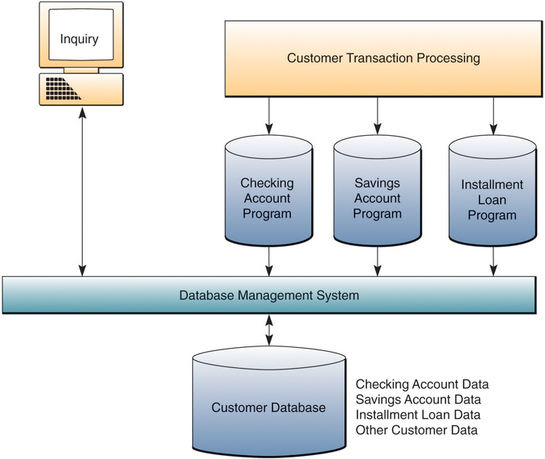
DATABASE MANAGEMENT SOFTWARE
Software that controls the creation, maintenance, and use of databases.

Slide 4
SCHEMA
set of formulas (sentences) called integrity constraints imposed on a database.
In a relational database, the schema defines the tables, fields, relationships, views, indexes, packages, procedures, functions, queues, triggers, types, sequences, materialized views, synonyms, database links, directories, XML schemas, and other elements.

Slide 5
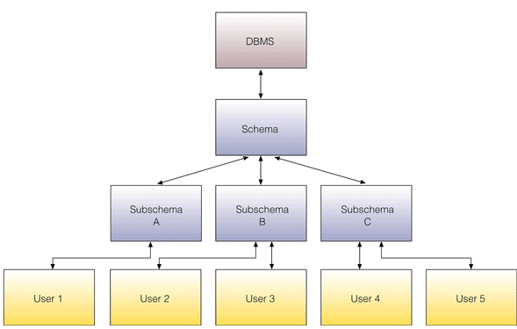
SCHEMA
Schema - A description of the database
Subschema – describes a subset of the database and which users have access to this subset.

Slide 6
ACID PROPERTIES
        Atomicity: A transaction is an atomic unit of processing, and it either has to be performed in its entirety or not at all.
        Consistency: A successful execution of a transaction must take a consistent database state to a (new) consistent database state.
        Isolation: A transaction must not make its modifications visible to other transactions until it is committed, i.e., each transaction is unaware of other transactions executing concurrently in the system.
        Durability: Once a transaction has committed its changes, these changes must never get lost due to subsequent (system)failures.

Slide 7
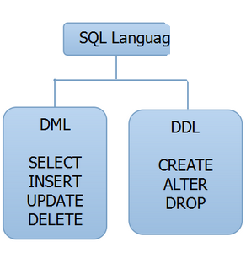
LANGUAGES OF SQL

Slide 8
DDL COMMANDS
Data Definition Language (DDL) statements are used to define the database structure or schema. Some examples:
1. CREATE - to create objects in the database
2. ALTER - alters the structure of the database
3. DROP - delete objects from the database

Slide 9
CREATE COMMAND
It is used to create schema of database objects.
SYNTAX:
>Create table emp(code char((5),name varchar(20), salary number(10));
> desc emp.

Slide 10
ALTER COMMAND
It is used to change or modify the existing structure.
A) To add a new field in existing structure
>alter table emp add (phoneno char(10));
>desc emp;
B) To modify datatype or size of any field into existing structure.
> alter table emp modify (code varchar(20));
> desc emp;

Slide 11
DROP COMMAND
It is used to delete schema or structure of database objects.
>drop table emp;

Slide 12
DML COMMANDS
Data Manipulation Language (DML)
statements are used for managing data within schema objects. Some examples:
1. SELECT - retrieve data from the a database
2. INSERT - insert data into a table UPDATE - updates existing data within a table
3. DELETE - deletes all records from a table, the space for the records remain

Slide 13
SELECT COMMAND
The SELECT statement is used to form queries for extracting information out of the database.
>SELECT <attribute>, ….., <attribute n> FROM <table name>;
> truncate table emp;

Slide 14
INSERT COMMAND
The insert statement is used to add new row to a table.
INSERT INTO <table name> VALUES (<value 1>, ... <value n>);
INSERT INTO STUDENT VALUES (1001,‘Ram’);
Character type values are always enclosed in single quotes;
number values are never in quotes;
Date values are often (but not always) in the format ‘yyyy-mm-dd’ (for example, ‘2006-11- 30’).

Slide 15
UPDATE COMMAND
The update statement is used to change values that are already in a table.
UPDATE <table name> SET <attribute> = <expression> WHERE <condition>;Example:
UPDATE STUDENT SET Name = ‘Amar’ WHERE StudID=1001;
The update expression can be a constant, any computed value, or even the result of a SELECT statement that returns a single row and a single column.

Slide 16
DELETE COMMAND
The delete statement deletes row(s) from a table.
DELETE FROM <table name> WHERE <condition>;
Example:
DELETE FROM STUDENT WHERE StudID=1001;
If the WHERE clause is omitted, then every row of the table is deleted that matches with the specified condition.

Slide 17
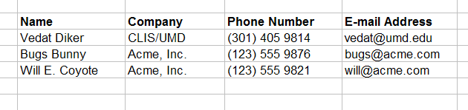
TABLES
“A table is the primary unit of physical storage for data in a database.”¹
Usually a database contains more than one table.

Slide 18
CREATE TABLES
CREATE TABLE tbl_employee
(
employee_id INT NOT NULL,
last_name VARCHAR(100) NOT NULL,
first_name VARCHAR(100) NOT NULL,
address VARCHAR(255) NULL
);

Slide 19
A Database with Multiple Tables
Publishers
Books
Customers
Authors
Inventory
Orders

Slide 20
Field (Column)
Record (Row)

Slide 21
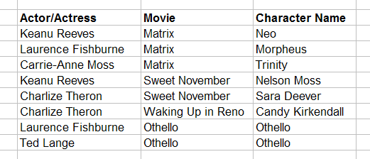
PRIMARY KEY
The PRIMARY KEY constraint uniquely identifies each record in a database table.
Primary keys must contain UNIQUE values, and cannot contain NULL values.
A table can have only one primary key, which may consist of single or multiple fields.

Slide 22
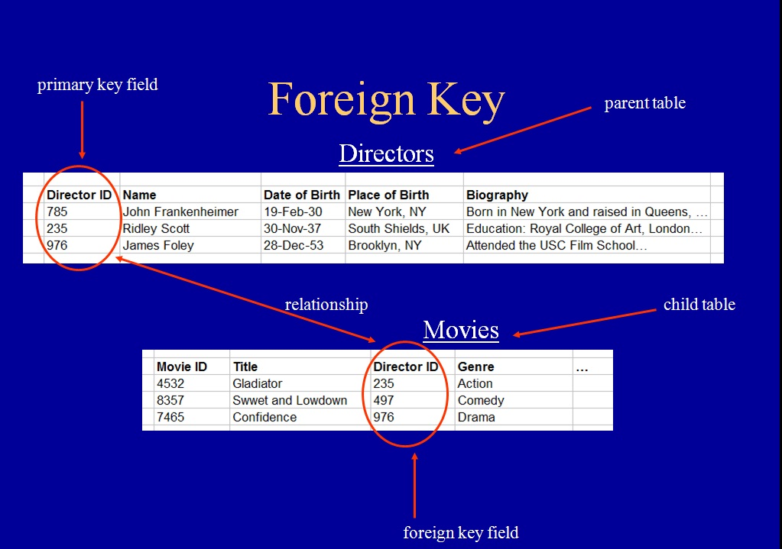
FOREIGN KEY
A FOREIGN KEY is a key used to link two tables together.
A FOREIGN KEY in a table points to a PRIMARY KEY in another table.

Slide 23
OPERATORS IN DATABASE
AIRTHMETIC OPERATOR
RELATIONAL OPERATOR
SET OPERATOR

Slide 24
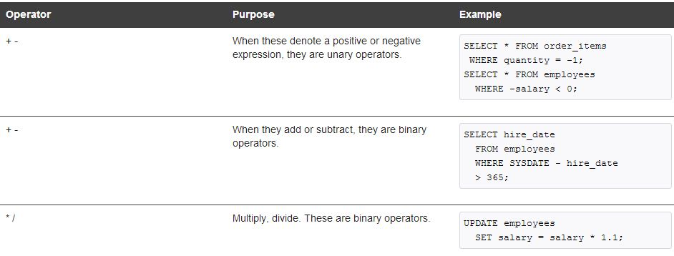
AIRTHMETIC OPERATORS

Slide 25
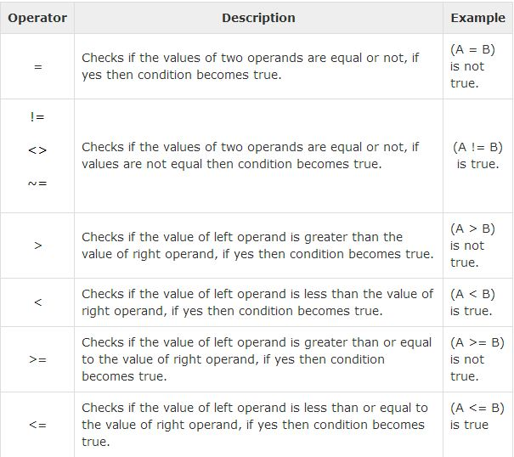
RELATIONAL OPERATOR

Slide 26
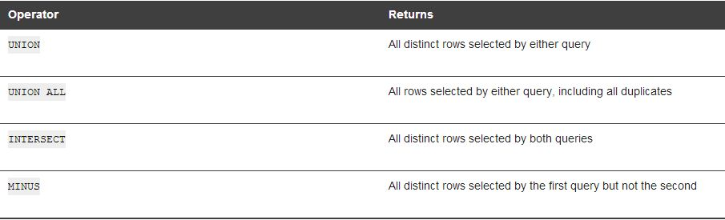
SET OPERATOR

Slide 27
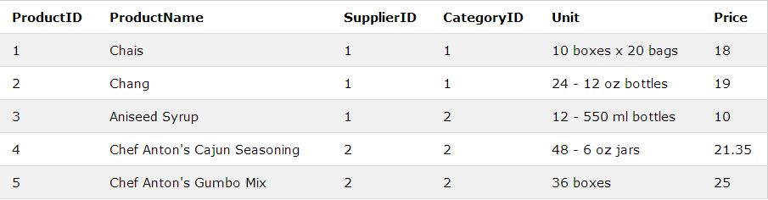
The MIN() Function
The MIN() function returns the smallest value of the selected column.
The following SQL statement gets the smallest value of the "Price" column from the "Products" table:
Example
SELECT MIN(Price) AS SmallestOrderPrice FROM Products;

Slide 28
THE MAX() Function
The MAX() function returns the largest value of the selected column.
SELECT MAX(Price) AS Largest Price FROM Products;

Slide 29


Slide 30

Nine coins are arranged in a triangle as shown in the picture below. You need to slide two coins to form a square. Can you do it?

Slide 31

It can be done as shown in the picture below.

Slide 32
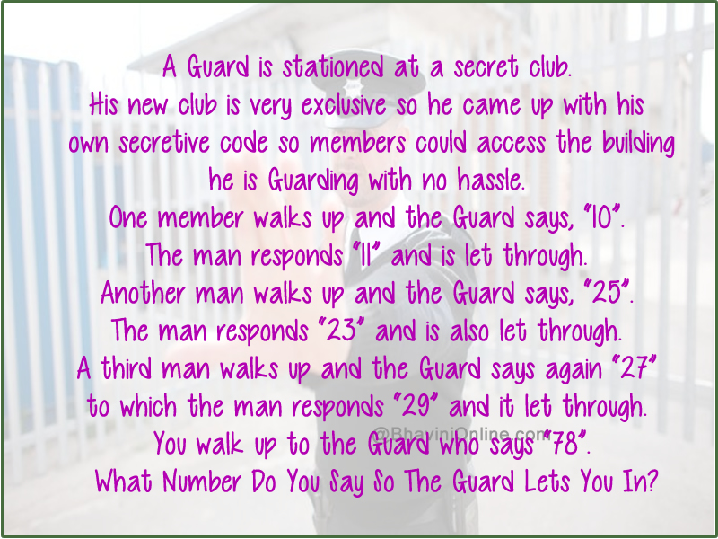

Slide 33
The answer to the Guards number would be the prime number closest to the number given by him.
So the prime numbers closest to the numbers given by the guard are;
for 10 its 11;
for 25 its 23;
for 27 its 29
So to get access to the club when the guard gives the number 78 your answer should be the prime number closest to 78 which is 79.
Answer: 79

Slide 34


